Slide 1
A Database Management Case Study
Group 2

Slide 2
Project Description:
Today, we'll be delving into a database management case study that involves analyzing sales and delivery data, as well as restaurant data.“
Our goal is to explore the complexities of the dataset and share valuable insights that can inform decision-making processes.

Slide 3
AGENDA
Case Study: Utilizing SQL for Real-World Data Analysis
Objective: Hands-on Learning of SQL for Practical Problem Solving.
Topics Covered: Data Challenges, SQL Solutions, Insights, SQL Trigger

Slide 4
Challenges Addressed
Schema Understanding:
Database schema involves multiple tables with distinct structures and relationships. Comprehending the schema is crucial for data navigation.
Data Extraction:
Extracting pertinent data demands SQL queries for selection, filtering, and table joins.
Calculation and Aggregation:
Complex metrics like order counts, delivery times, sales, and profit require precise SQL functions.
Data Presentation:
Effective results communication is vital, ensuring clarity and organization.
.

Slide 5
Methodology
SQL & MySQL 8.0:
SQL and MySQL Workbench 8.0 were our primary tools.
Versatile SQL:
SQL's adaptability makes it ideal for data tasks.
Data to Insights:
SQL bridges data and insights efficiently.
Transferable Skills:
Proficiency in SQL has broad applications.

Slide 6
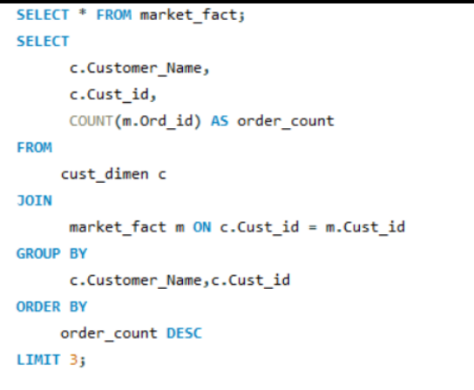
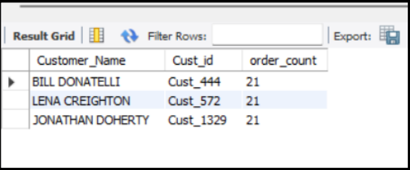
Problems & solutions on sales and delivery
Question 1: Find the top 3 customers who have the maximum number of orders
COUNT(m.Ord_id) AS order_count: We use the COUNT() function to calculate the number of orders for each customer. We alias this count as order_count for readability in the result.
We use a JOIN operation to combine the two tables based on the common Cust_id column. This links customer data from cust_dimen with order data from market_fact.
GROUP BY Clause: We group the results by Customer_Name and Cust_id. This means that the count of orders will be calculated for each unique customer.
ORDER BY Clause: We sort the results in descending order of order_count. This means that customers with the most orders will appear at the top.
LIMIT Clause: Finally, we use the LIMIT clause to restrict the result set to the top 3 rows, which gives us the three customers with the maximum number of orders.

Slide 7
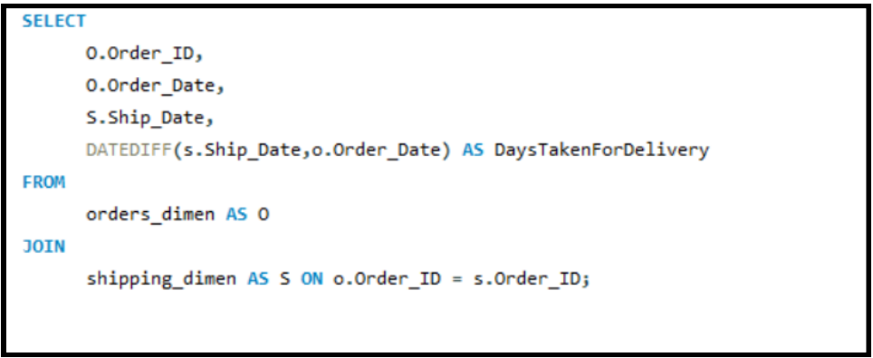
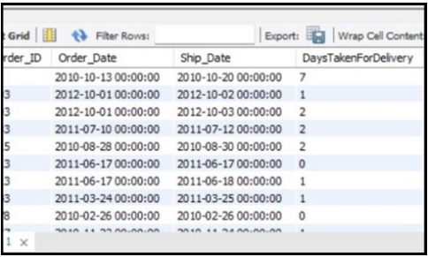
Problems & solutions
Question 2: Create a new column DaysTakenForDelivery that contains the date difference between Order_Date and Ship_Date.

Slide 8
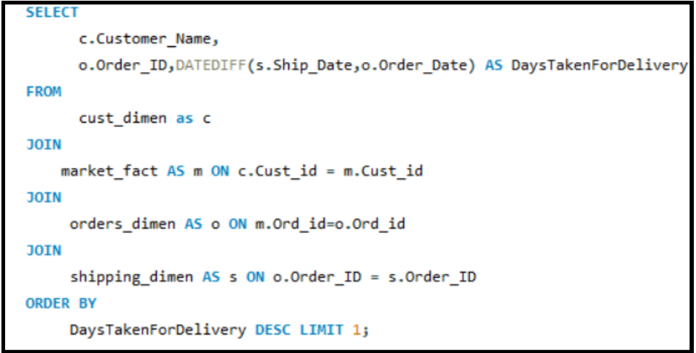
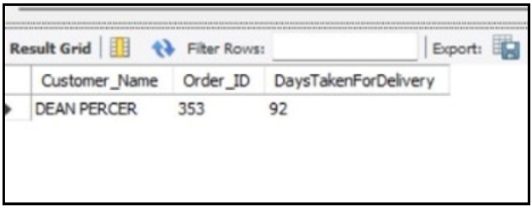
Problems & solutions
Question 3: Find the customer whose order took the maximum time to get delivered.

Slide 9
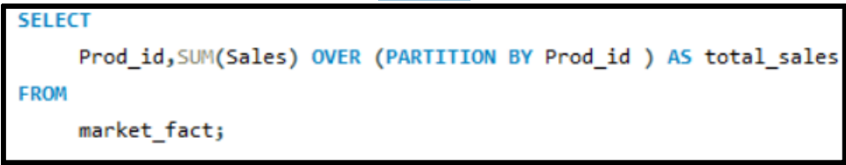
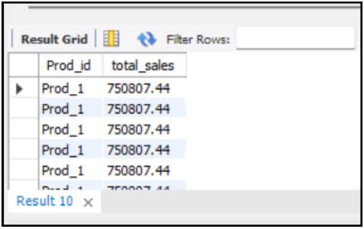
Problems & solutions
Question 4: Retrieve total sales made by each product from the data (use Windows function).

Slide 10
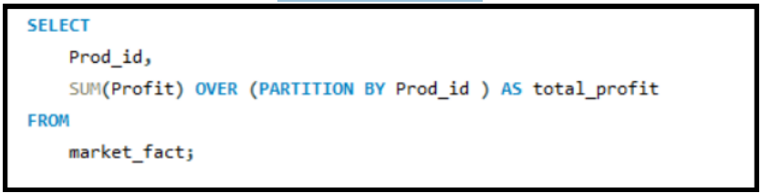
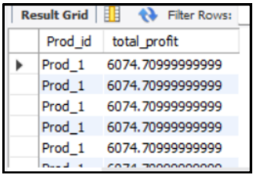
Problems & solutions
Question 5: Retrieve the total profit made from each product from the data (use windows function).

Slide 11
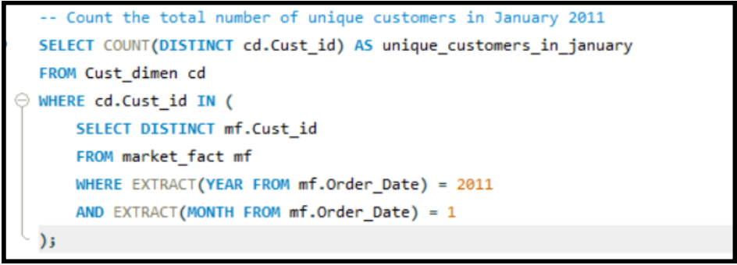
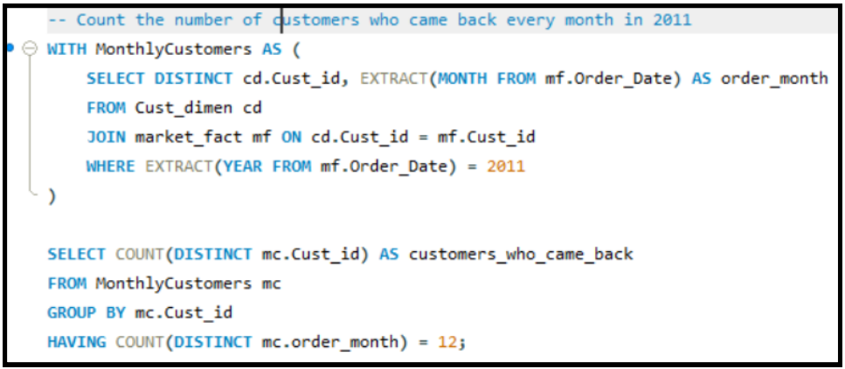
Problems & solutions
Question 6: Count the total number of unique customers in January and how many of them came back every month over the entire year in 2011 Count the total number of unique customers in January 2011.
By nesting The conditions within the subquery and comparing customer IDs, the main query counts how many unique customers from the Cust_dimen table placed orders in January 2011.
The result, stored in unique_customers_in_january, represents the count of such unique customers.
This query first identifies customers who placed orders in each month of 2011 using the CTE, and then counts how many of them continued to make purchases every month throughout the entire year.
The result, stored in customers_who_came_back, represents the count of such loyal customers.

Slide 12
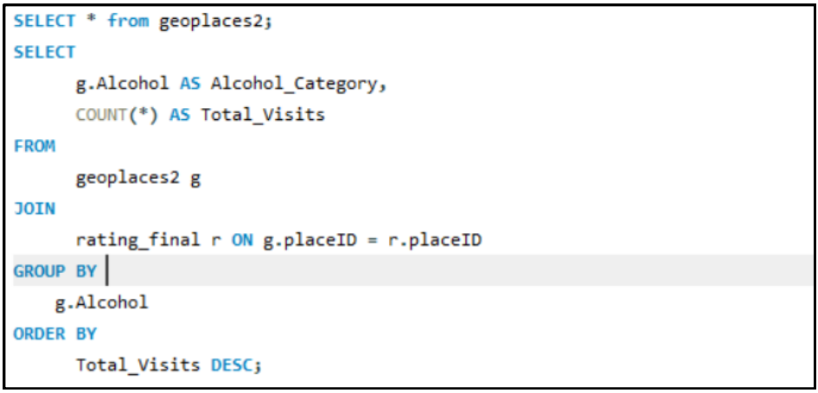
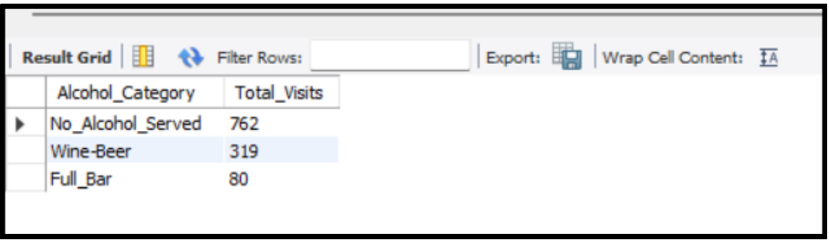
Problems & solutions on restaurant
Question 1: - We need to find out the total visits to all restaurants under all alcohol categories available.
The Above query is used to calculate and display the total number of visits for each category of places based on whether they serve alcohol or not. It leverages a join operation between two tables (geoplaces2 and rating_final) and aggregates the data using GROUP BY. The result is ordered in descending order to show the most popular alcohol categories at the top

Slide 13
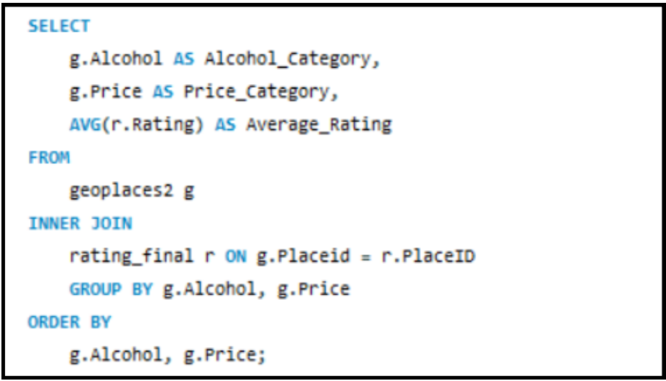
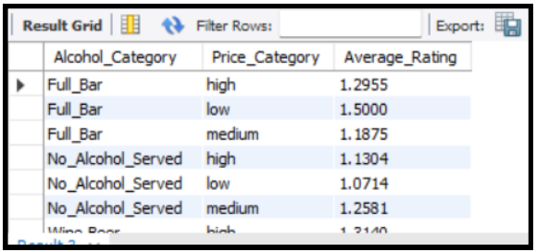
Problems & solutions on restaurant
Question 2: -Let's find out the average rating according to alcohol and price so that we can understand the rating in respective price categories as well.
This SQL query retrieves data from the geoplaces2 and rating_final tables, calculates the average rating for each combination of "Alcohol_Category" and "Price_Category," and presents the results in a structured manner, ordered by the specified categories. It provides insights into the average ratings for different types of places based on their alcohol availability and price range

Slide 14
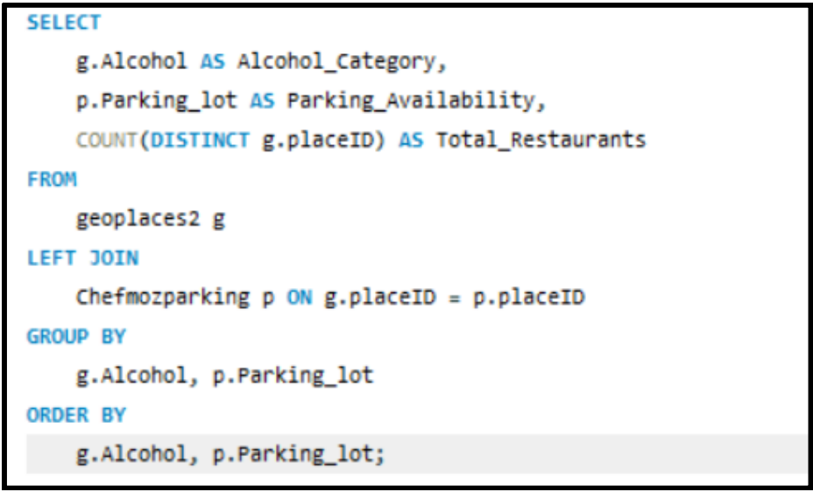
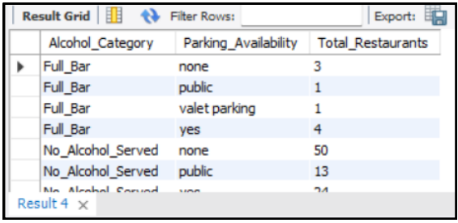
Problems & solutions on restaurant
Question 3: Let’s write a query to quantify that what are the parking availability as well in different alcohol categories along with the total number of restaurants.
This SQL query retrieves data from the geoplaces2 and Chefmozparking tables, calculates the count of distinct restaurants for each combination of "Alcohol_Category" and "Parking_Availability," and presents the results in a structured manner, ordered by the specified categories. This can provide insights into the distribution of restaurants based on their alcohol availability and parking lot availability.

Slide 15
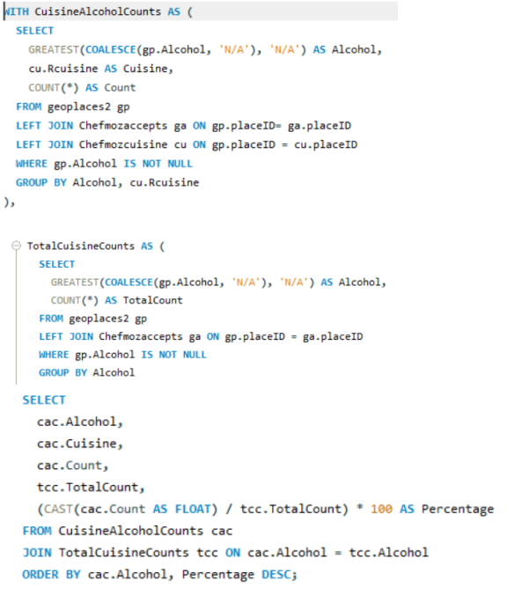
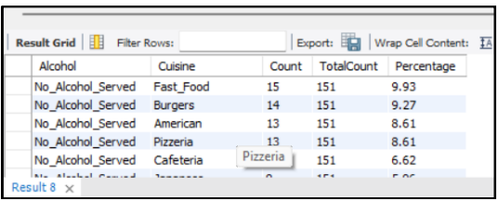
Problems & solutions
Question 4: -Also take out the percentage of different cuisine in each alcohol type.

Slide 16
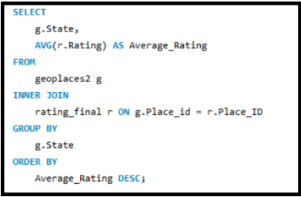
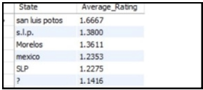
Problems & solutions
Questions 5: - let’s take out the average rating of each state.

Slide 17
Problem on Trigger
Question 1: Create two table called Student_details and Student_details_backup.
Table 1: Attributes
Table 2: Attributes Student id,
Student name, mail id, mobile no.
Student id, student name, mail id, mobile no.
You have the above two tables Students Details and Student Details Backup. Insert some records into Student details.
Problem:
Let’s say you are studying SQL for two weeks. In your institute, there is an employee who has been maintaining the student’s details and Student Details Backup tables. He / She is deleting the records from the Student details after the students completed the course and keeping the backup in the student details backup table by inserting the records every time. You are noticing this daily and now you want to help him/her by not inserting the records for backup purpose when he/she delete the records.write a trigger that should be capable enough to insert the student details in the backup table whenever the employee deletes records from the student details table.
Note: Your query should insert the rows in the backup table before deleting the records from student details.

Slide 18
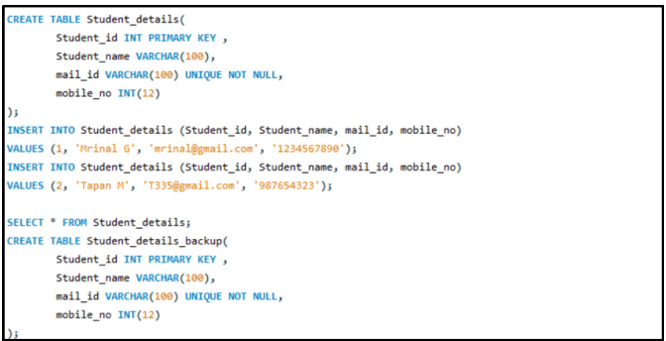
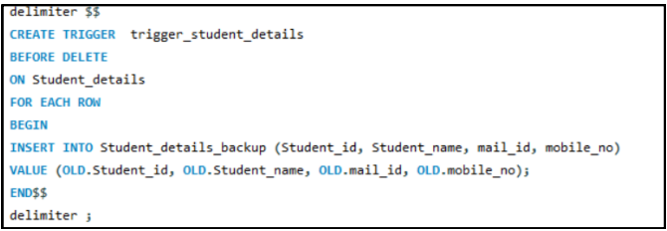
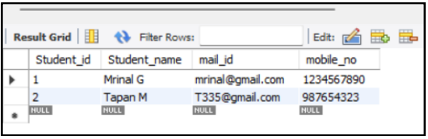
Solution
CREATING TABLES AND INSERTING DATA
Created Trigger
STUDENT DETAIL

Slide 19
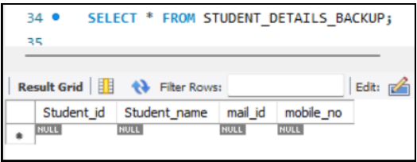
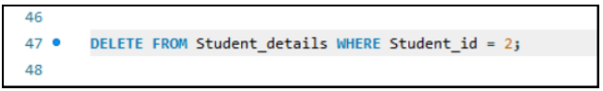
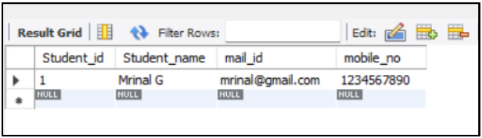
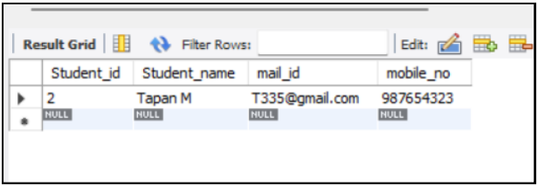
Solution
STUDENT DETAILS BACKUP
DELETING DATA FROM MAIN TABLE
BACKUP TABLE AFTER DELETE
STUDENT DETAILS TABLE AFTER DELETE

Slide 20
Project Findings and Recommendations
Popular Menu Items and Delivery Times: Identify customer favorites and peak delivery times for better resource allocation.
Repeat Customers: Offer incentives to retain loyal customers through discounts and promotions.
Delivery Performance: Optimize routes and consider hiring additional drivers to improve delivery times and reduce missed deliveries.
Data Backup Trigger: Regularly back up sales and delivery data to safeguard against hardware or software failures.
Ongoing Data Monitoring: Continuously analyze sales and delivery data to address emerging issues and inform decisions.

Slide 21
FUTURE CONSIDERATION AND TAKEAWAY
Skills Gained: Enhanced data analysis, preparation, and database management skills.
Real-World Application: Applying skills to drive data-driven decisions and operational optimization.
Continuous Learning: Commitment to staying updated on data analytics and database management.
Data Quality Emphasis: Prioritizing data quality and governance for accurate results.
Advanced Analytics: Exploring advanced analytics and machine learning for complex challenges.
Relevance in Business: Equipped with practical knowledge for today's data-driven business landscape.

Slide 22




MEET OUR TEAM
Harpreet Kaur
Abhin
Vaishali Tiwari​
SUSMITA MANNA
Member no 1
Member no 2
Member no 3
Member no 4

